Slide 1
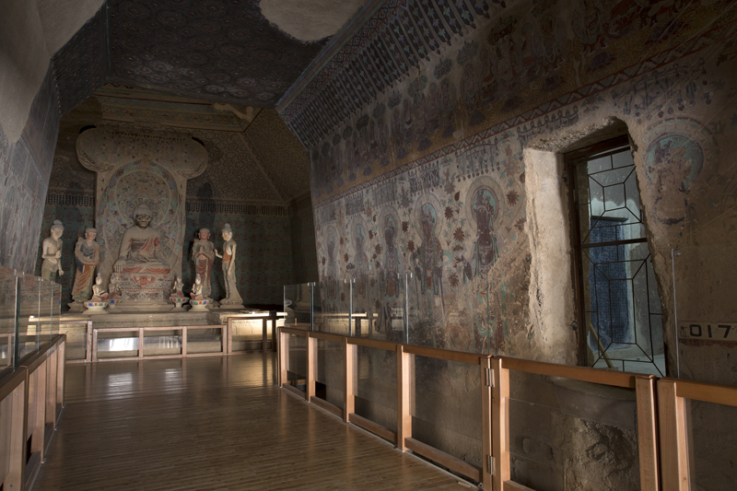
RESEARCH OBJECT
01
Tracing the Early Dispersal of the Library Cave Manuscripts, 1900–1910
A Pilot Study of the Stein and Qing Government Routes
Research focus
Manuscripts from Mogao Cave 17 (the Library Cave)
1900–1910
Stein route · Qing government route
Progress report：
[1]Data coding
[2]Gephi pilot
[3]Next steps and expected outputs
HY5419 · Digital History

Slide 2
QUESTION
02
Research Questions
Full project: Beijing, London and Paris
MAIN QUESTION
Who mediated the early dispersal of Library Cave manuscripts, 1900–1910?
01
Which intermediaries?
02
How do sources describe transfers?
Custodians, translators, officials and collecting institutions
Language of acquisition, removal and preservation
Working Hypothesis
Intermediaries and collecting institutions jointly shaped early dispersal.
HY5419 · Digital History

Slide 3
METHOD / DATA
03
Data and Methods
Three linked tables support a directed network in Gephi
01
02
03
NODES
EVENT RECORDS
SOURCES
Site / People / Expeditions / Institutions
→
Source / Target / Date / Relationship
→
Citation / Page / Original wording
Rule A
Separate wording from coding
Rule B
Retain date ranges and units
Rule C
Link every record to a source
HY5419 · Digital History

Slide 4
PRELIMINARY RESULT
04
Gephi Pilot Network
Provisional coding of the Stein and Qing government routes
7/6/9
nodes / links / draft records
Observation 1
Wang links both routes in the pilot.
Observation 2
Jiang appears in the removal stage.
GAP
Qing orders and handovers need separate evidence.
Exploratory directed network of documented transfer records; layout distance is not geographic distance.
Evidence Sources：Stein 1921; Doumy 2025; Terzi and Whitfield 2024. Data files: nodes.csv, edges.csv, sources.csv.
HY5419 · Digital History

Slide 5
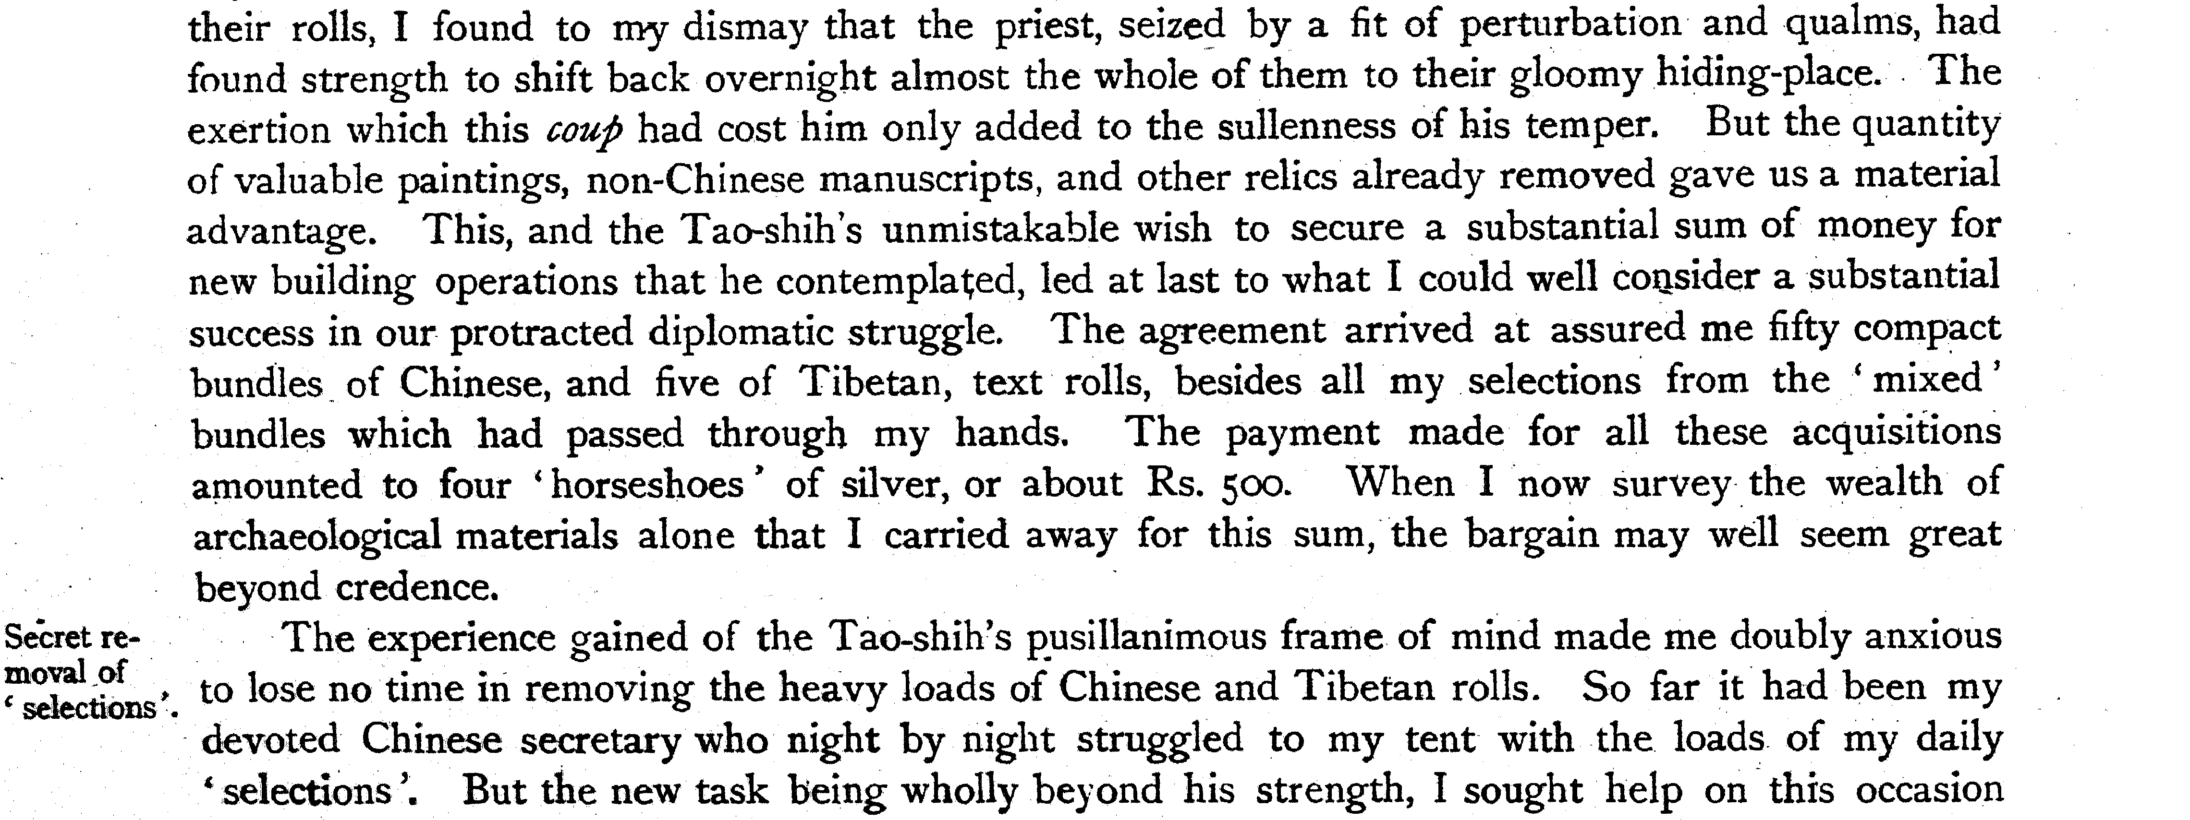
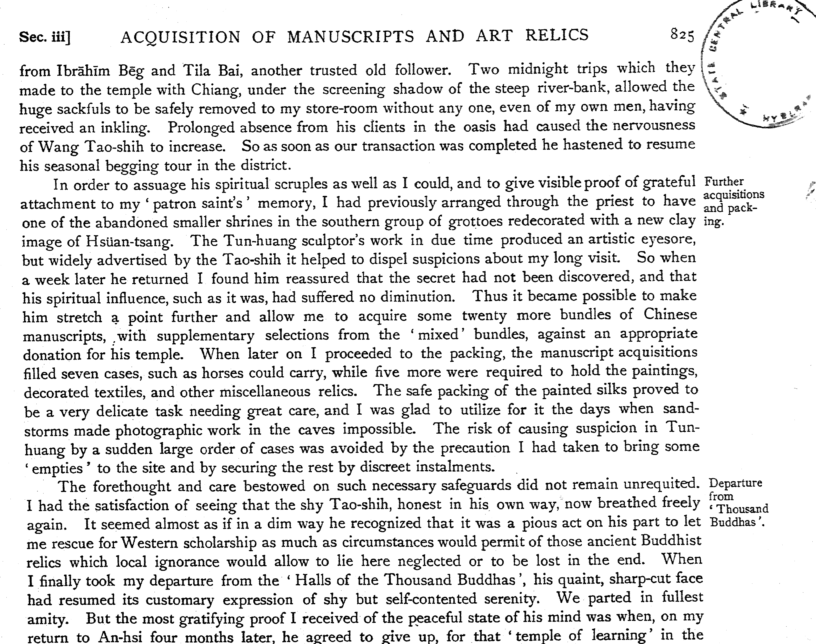
EVIDENCE
05
Stein’s Account of Acquisition
Serindia, vol. 2, pp. 824–825
01
Agreement
Stein’s account of the transaction
02
Safely removed
Night removal involving intermediaries
03
Rescue
A justification based on scholarly value
Conclusion :
Source wording and event coding remain separate.
M. Aurel Stein, Serindia, vol. 2 (1921), pp. 824–825. Internet Archive.
HY5419 · Digital History

Slide 6
NEXT STEPS AND EXPECTED OUTPUTS
06
Next Step
01
02
03
Audit the pilot dataset
Extend the routes and evidence
Complete the analysis and publication
Review duplicate records, date ranges, source links, and the distinction between Qing orders and physical handovers.
Add the Pelliot route and supplement the dataset with Chinese archives, collection catalogues and accession records.
Build an event timeline, develop three manuscript or event case studies, and prepare the project website.
Expected Outputs
A traceable dataset
Network and route comparison
An evidence-based historical interpretation
Linked records of nodes, events, sources and evidence levels.
Linked records of nodes, events, sources and evidence levels.
Use source wording to discuss dispersal, collection narratives and gaps in the evidence.
HY5419 · Digital History
THANK YOU

